Slide 1
Care of the Patient with
End-Stage Renal Disease

Slide 2
Objectives
To provide a basic understanding of:
  End-Stage Renal Disease (ESRD)
  Treatment Options for ESRD
  Vascular Access
  Dietary and Medical Management

Slide 3
ESRD in the United States
  Approximately 477,000 dialysis patients
  Approximately 201,000 kidney transplant patients
  More than 72% of new patients have diabetes and/or high blood pressure
  88,231 patients awaiting transplant
  Most patients have multiple co-morbid conditions
  Greater than 6,300 dialysis facilities
  More than 300 kidney transplant centers
  9th leading cause of death in the United States
2014 Data from 2016 USRDS Report

Slide 4
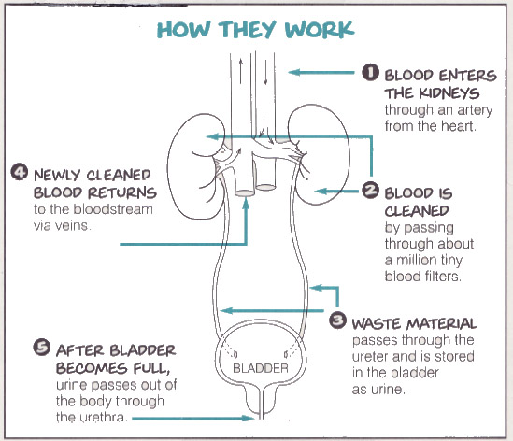
How Do Kidneys Work?
Notes:
How Do Your Kidneys Work?
Blood enters the kidneys through an artery from the heart
Blood is filtered by passing through the millions of tiny blood filters called “nephrons”
Filtered blood returns to the bloodstream via veins
Waste is changed into urine. Urine flows down the ureters and is stored in the bladder.
When the bladder is full, urine is passed from the body through the urethra

Slide 5
How Do Kidneys Keep you Healthy?
Remove waste products from the body
Balance the body’s fluids
Regulate hormones
Help to keep blood pressure under control
Keep bones healthy
Help to make red blood cells
Notes:
How do kidneys keep you healthy?
Kidneys are important because they keep the rest of your body’s systems in balance. Kidneys:
Remove waste products from the body
Balance the body’s fluids
Regulate hormones
Help keep blood pressure under control
Keep bones healthy
Help make red blood cells

Slide 6
What Causes Chronic
Kidney Disease?
Some common causes are:
  Diabetes
  High blood pressure
  Glomerulonephritis (GN)
  Polycystic kidney disease (PKD)
  Congenital disease
  Drugs and toxic chemicals
  Urinary tract infections
Notes:
There are many causes of CKD. Some of the most common causes are:
Diabetes
High blood pressure
Glomerulonephritis
Diseases that are inherited, such as polycystic kidney disease
Congenital disease
Exposure to some drugs and toxic chemicals
Chronic urinary tract infections
(We will talk a little more about each of these causes of CKD in the next few slides)

Slide 7
Dialysis Care Team
Patient
Nephrologist
Nurse
Technician
Dietitian
Social Worker

Slide 8
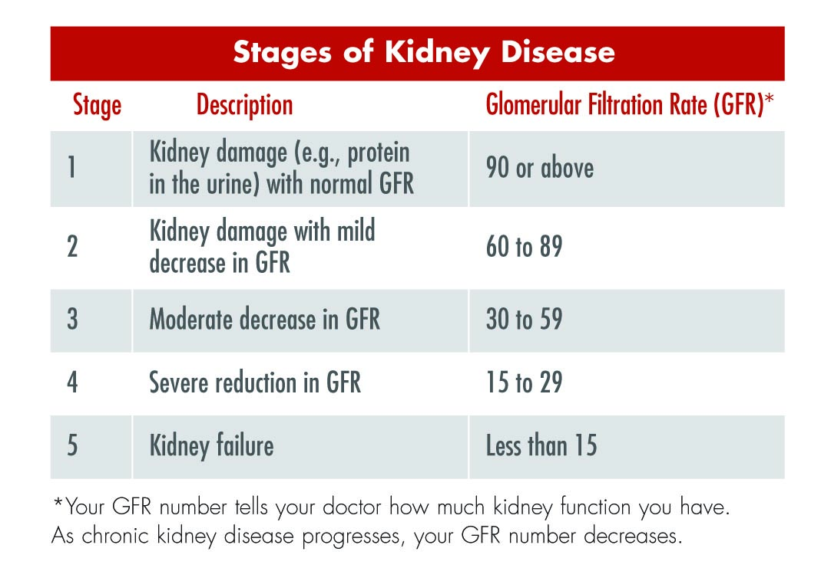
Stages of Kidney Disease
Early detection and treatment may help slow progression of kidney failure.
Notes:
There are 5 stages of kidney disease.
Stage 1 – Some loss in kidney function.
Stage 2 – Mild loss in kidney function. This may mean that your kidneys are not working at full strength. When kidney disease is found and treated in these early stages, it may be possible to slow – or even stop – losing more kidney function.
Stage 3 – Moderate CKD. At this stage, about half of kidney function has been lost. This can cause other problems to develop, like high blood pressure or bone problems. Treatment of these problems is very important, and it can even help slow down the loss of kidney function.
Stage 4 – Severe CKD. At stage 4, you should learn all you can about kidney failure and treatment choices for kidney failure. This will help you choose the treatment (dialysis or transplant) that you and your doctor think is best for you -- if your kidneys fail.
Stage 5 – Kidney Failure (GFR less than 15). Treatments like dialysis or transplant are needed at stage 5.

Slide 9
Types of Kidney Failure
Acute Renal Failure
  Usually sudden onset
  Kidneys likely to recover function
Chronic Renal Failure
  End-Stage Renal Disease requires treatment by dialysis or transplantation
  Kidneys unlikely to recover function

Slide 10
Treatment Options
Transplant
Hemodialysis
  In-Center Hemodialysis
  Home hemodialysis
  Nocturnal Dialysis
  Daily Short Dialysis
Peritoneal Dialysis
  Continuous Ambulatory PD (CAPD)
  Continuous Cyclic PD (CCPD)
No Treatment / comfort care

Slide 11
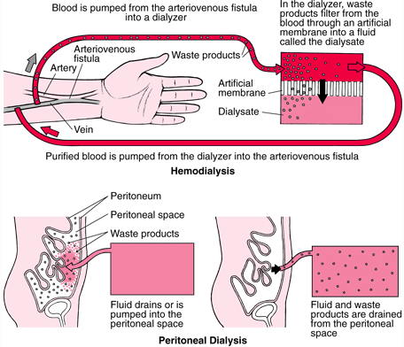
Hemodialysis vs Peritoneal Dialysis

Slide 12
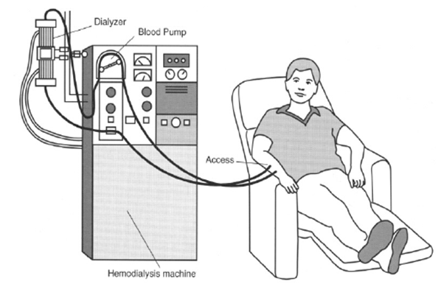
Hemodialysis (HD)
  In-center
  Home
    Daily or every other day
    Treatment time varies by patient
  Nocturnal: Home or In-center
    Hemodialysis machine
    Purified water

Slide 13
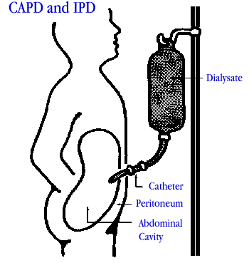
Peritoneal Dialysis (PD)
  Continuous Ambulatory PD (CAPD)
    Manual with no machinery involved
    Performed 24/7
    Approximately one 18” x 11” x 8”
    Case of supplies is used daily
  Continuous Cycler PD (CCPD)
    Automated using a delivery machine
    Usually done only at night
    (6-7 nights/week)

Slide 14
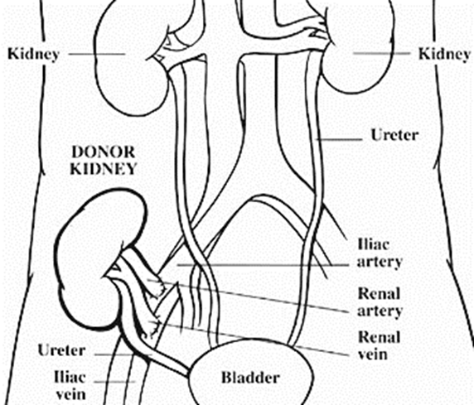
Transplantation
  Take special drugs to prevent rejection of the kidney
  Some medications diminish the body’s ability to fight infection
  Avoid exposure to infections

Slide 15
The Hemodialysis Prescription
Nephrology nurses affect positive patient outcomes through assurance of delivery of adequate dialysis prescription
Nursing assessment crucial in determining patient response to therapy
  Monitor for s&s of:
    Uremia
    Fluid volume status
    Anemia
    Nutritional status
    Bone disease
Notes:
This comprehensive assessment along with measurement of Kt/V and determination of patient’s functional status, quality of life and well-being provide a total picture of the patient and the response to therapy.

Slide 16
There Is More To Caring For The Patient Than Just Dialysis
Coping with Dialysis
  Emotional issues
  Financial issues
  Health concerns
Maintaining Patient Confidentiality
Patient Education
Rehabilitation

Slide 17
Vascular Access for Hemodialysis
  There are three types of vascular access used for hemodialysis:
  Arteriovenous fistula (AVF)
  Arteriovenous graft (AVG)
  Central vein catheter (CVC)

Slide 18
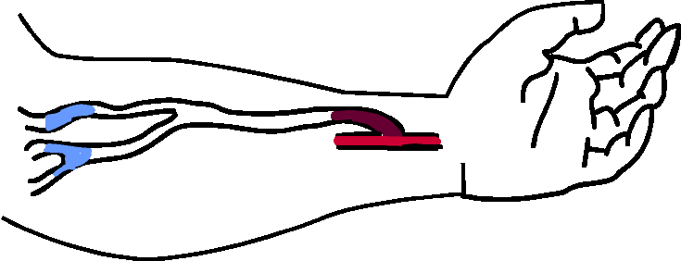
Arteriovenous Fistula
Artery
Vein
Pros:
Lasts longer
Not prone to infection
Provides excellent blood flow once it is ready to use
Less likely to develop blood clots and become blocked
You can take showers once the access heals after surgery
Cons:
Needs to mature one to four months before it can be used
Needles are inserted to connect to the dialysis machine

Slide 19
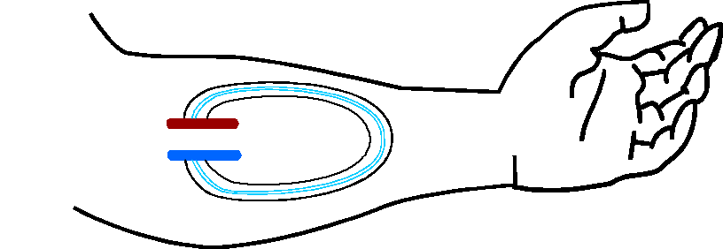
Arteriovenous Graft-Loop
Pros:
Provides excellent blood flow once it is ready to use
You can take showers once the access heals after surgery
Cons:
Lasts less time than an AV fistula
More prone to infection than an AV fistula
Needs at least two weeks before it can be used
Clotting can be a problem that may require surgery or other treatment to correct
Needles are inserted to connect to the dialysis machine

Slide 20
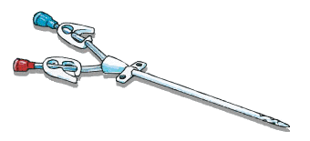
Central Venous Catheter
Pros:
Can be used right away
No needles are needed to connect to the machine
Cons:
Usually a temporary access
Most prone to infection
May not have the blood flow needed for enough dialysis
Blood clots can form that block the flow of blood through the catheter
Protective cover is needed for the catheter to take a shower
Can cause narrowing of major blood vessels

Slide 21

Vein Preservation
  From onset of diagnosis, it is critical to protect the patient’s veins for future use as vascular access sites.
  Blood draws an IVs should be limited, and located in the dorsum of the hand if possible.
  PICC lines should be avoided, as they cause scaring and stenosis of vessels that may be needs as dialysis access.

Slide 22
Access Preservation
  Protection of access:
    Protect from injury
    No blood pressure (BP), IVs, or lab draws in access arm
    Do not carry heavy items on access arm (such as a purse or tight jewelry)
    Access is for dialysis only

Slide 23
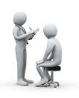
Clinical Assessment
  Ascertain when the patient received their last dialysis treatment
  Assess fluid status
    Is there periorbital or pedal edema?
    May not be unusual for this patient
  Listen to the lungs
    Do they have rales or rhonchi?
    Are they short of breath?
  Cardiac status
    Take blood pressure and pulse
    Are the BP and pulse “normal” for the patient?
    Is the heart rate regular?
  Infection
    Is the patient’s temperature elevated?
    Is the CV catheter site clean and dry?
    Is the PD catheter site clean and dry?
    For PD patients: is the abdomen firm, tender to touch?

Slide 24
Basic Laboratory Values
Dialysis Adequacy: URR and kt/v
Anemia Management:
Hemoglobin, T-Sat, Ferritin
Bone Mineral Metabolism:
Calcium, Phosphorus, PTH
Electrolytes: Potassium
Nutritional: Albumin

Slide 25
Common Medications
Erytropoetin Stimulating Agent (ESA)
Intravenous Iron
Active Vitamin D
Calcimmetic
Phosphate Binder
Renal Vitamin

Slide 26
Diet and Fluid Restrictions
  Fluid is anything that is liquid at room temperature
  Fluid should be limited to two cups per day
  Phosphorus is hidden in many foods. It is important that phosphate binders are taken with meals.
  Food high in potassium and salt should be avoided:
    Foods high in potassium could effect heart rhythm
    Excess salt can lead to the retaining of fluid

Slide 27
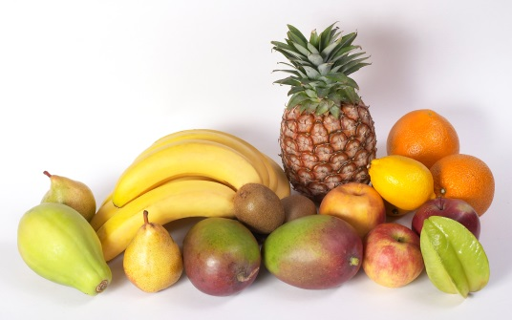
Foods Very High In Potassium
  Beans, peanuts, soybeans, lentils, peas
  Sweet and white potatoes
  Dried fruit: apricots, raisins, peaches
  Avocados, cantaloupe
  Banana, plantains
  Artichokes, winter squash, pumpkin, parsnips
  Beet greens, spinach, Swiss chard, cabbage
  Milk, soymilk
  Tomatoes, okra, canned mushrooms
  Oranges

Slide 28

Questions? Contact membership@kidney.org

